Slide 1
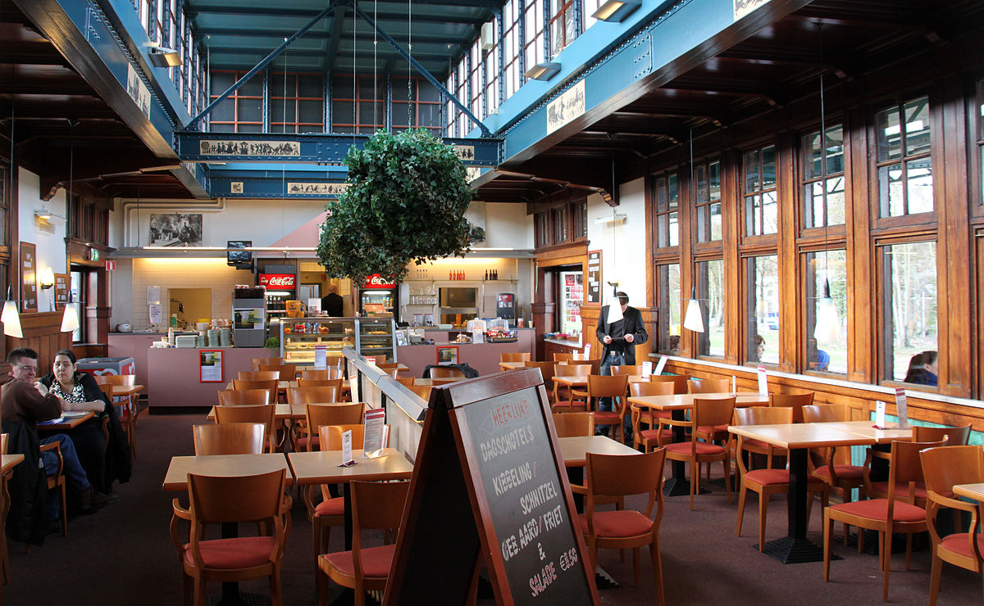
Restaurants in Famous Indian Cities
An Analytical Study based on popular choices
This Photo by Unknown Author is licensed under CC BY-SA

Slide 2
The Problem Clustering restaurants from different cities in india will help determine some common characteristics between them. Analyzing these different venues, we can visualize the following data
Groups of cities similar to each other w.r.t restaurants
Why these places are so populated?
What characteristics do they share?
Why these places are so populated?

Slide 3
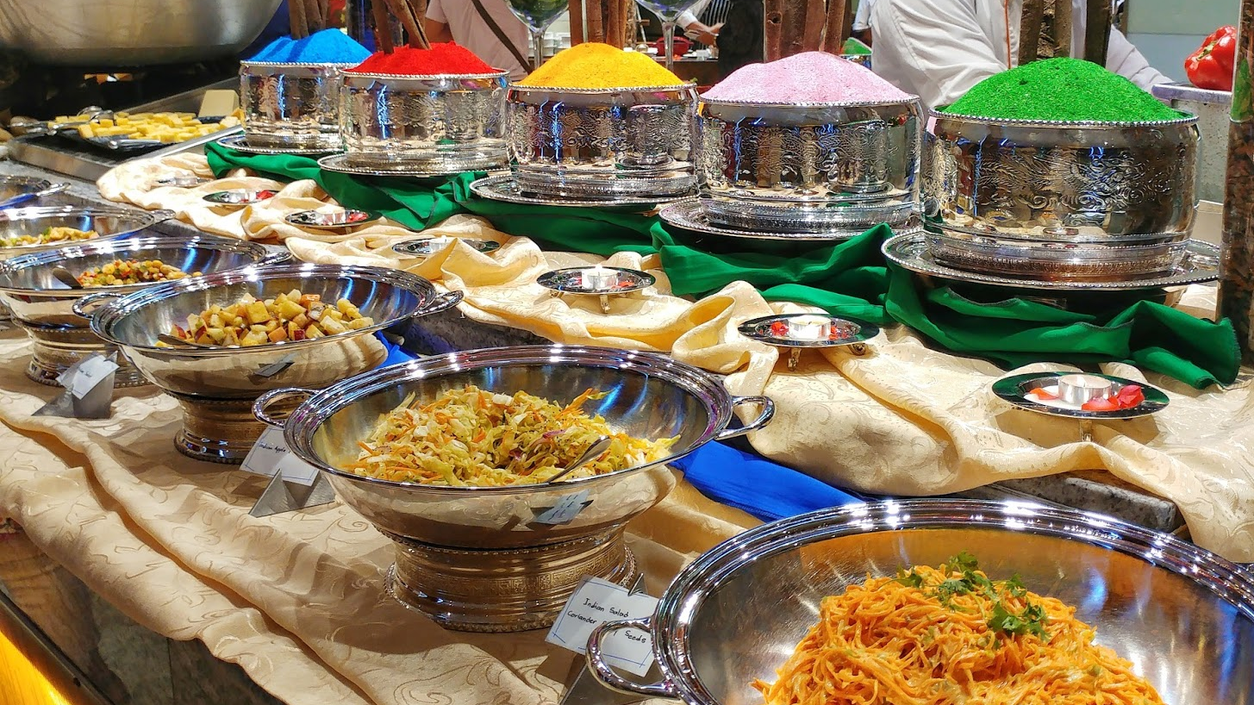
Interest
Say if one were to visit a famous Indian city and would want to acquire knowledge of the best food spots. Or better still maybe some entrepreneur wants to set up base with a restaurant, he/she will need to know the kind of cuisines and eateries the general public picks. With the attained information from this study, these individuals will be able to make their stay and capital more profitable.
This data can also be useful for culinary experts and food critics to categorize and rate famous places based on their similarities.
This Photo by Unknown Author is licensed under CC BY

Slide 4
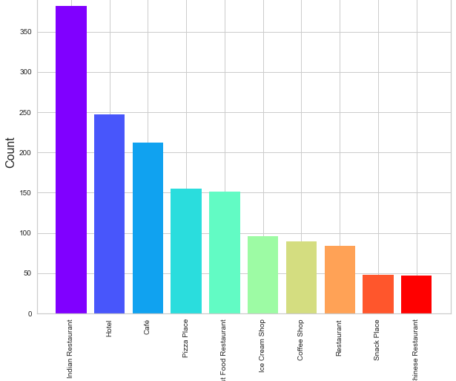
Distribution of restaurants based on their category

Slide 5
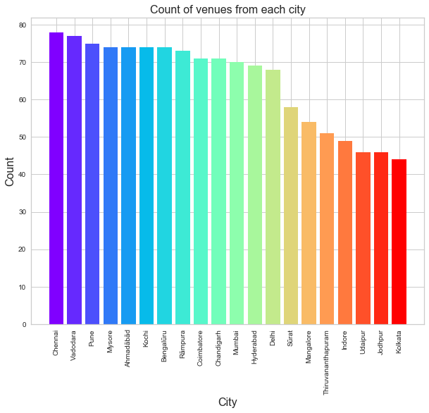
Cities with most restaurants
From this chart, we understand that most venues were acquired from more populated cities like Chennai, Vadodara, Pune, Mysore, Mumbai, Hyderabad etc.

Slide 6
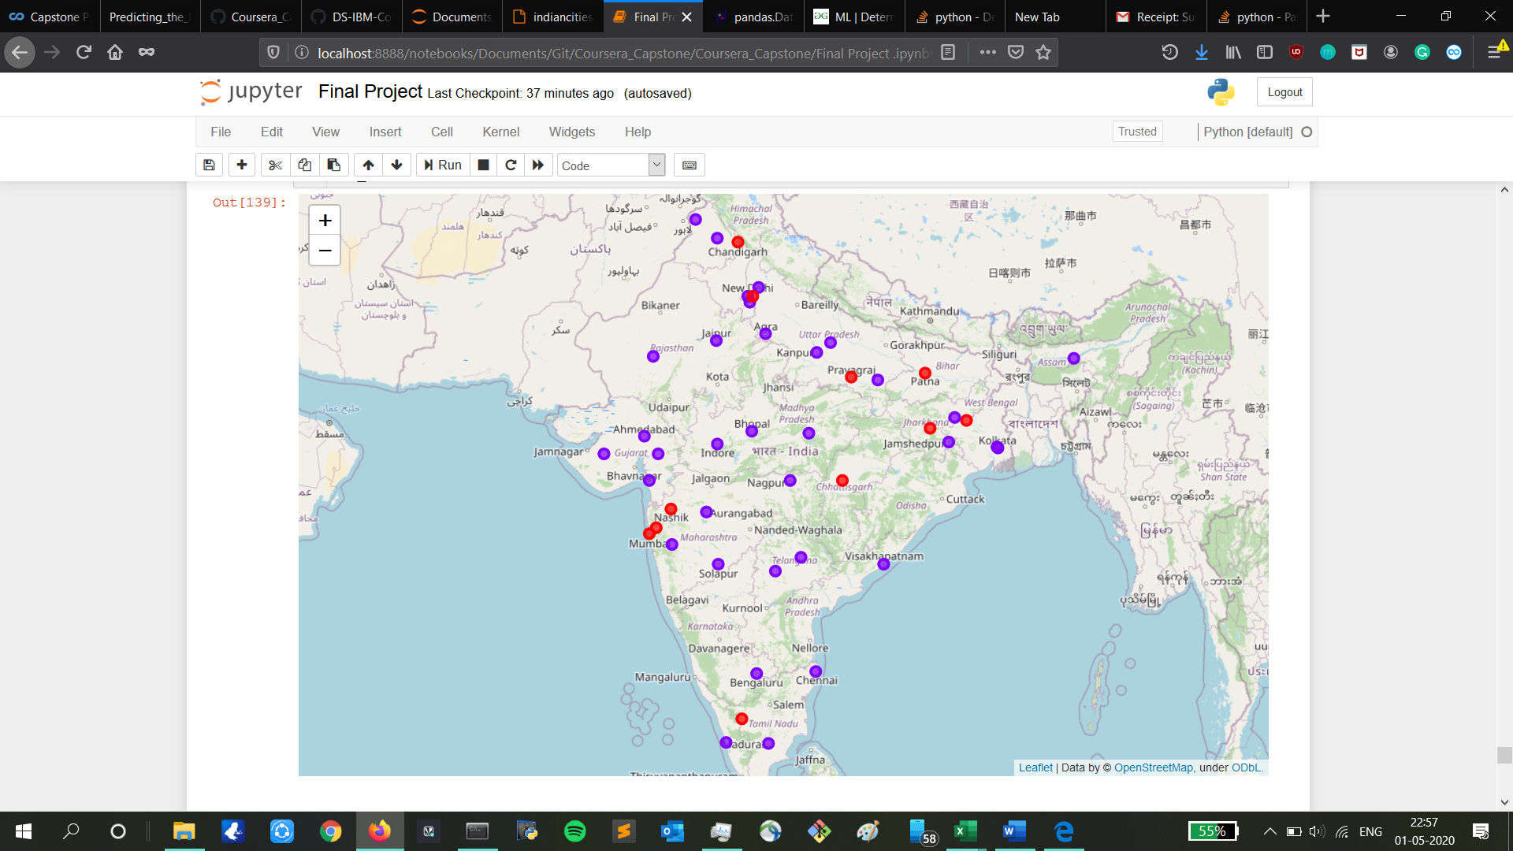

Slide 7
Clustered cities based on popular eating spots
Observations:
The first cluster is very sparsely spread and has very limited venues.
The second cluster is spread across country and includes the major cities.

Slide 8
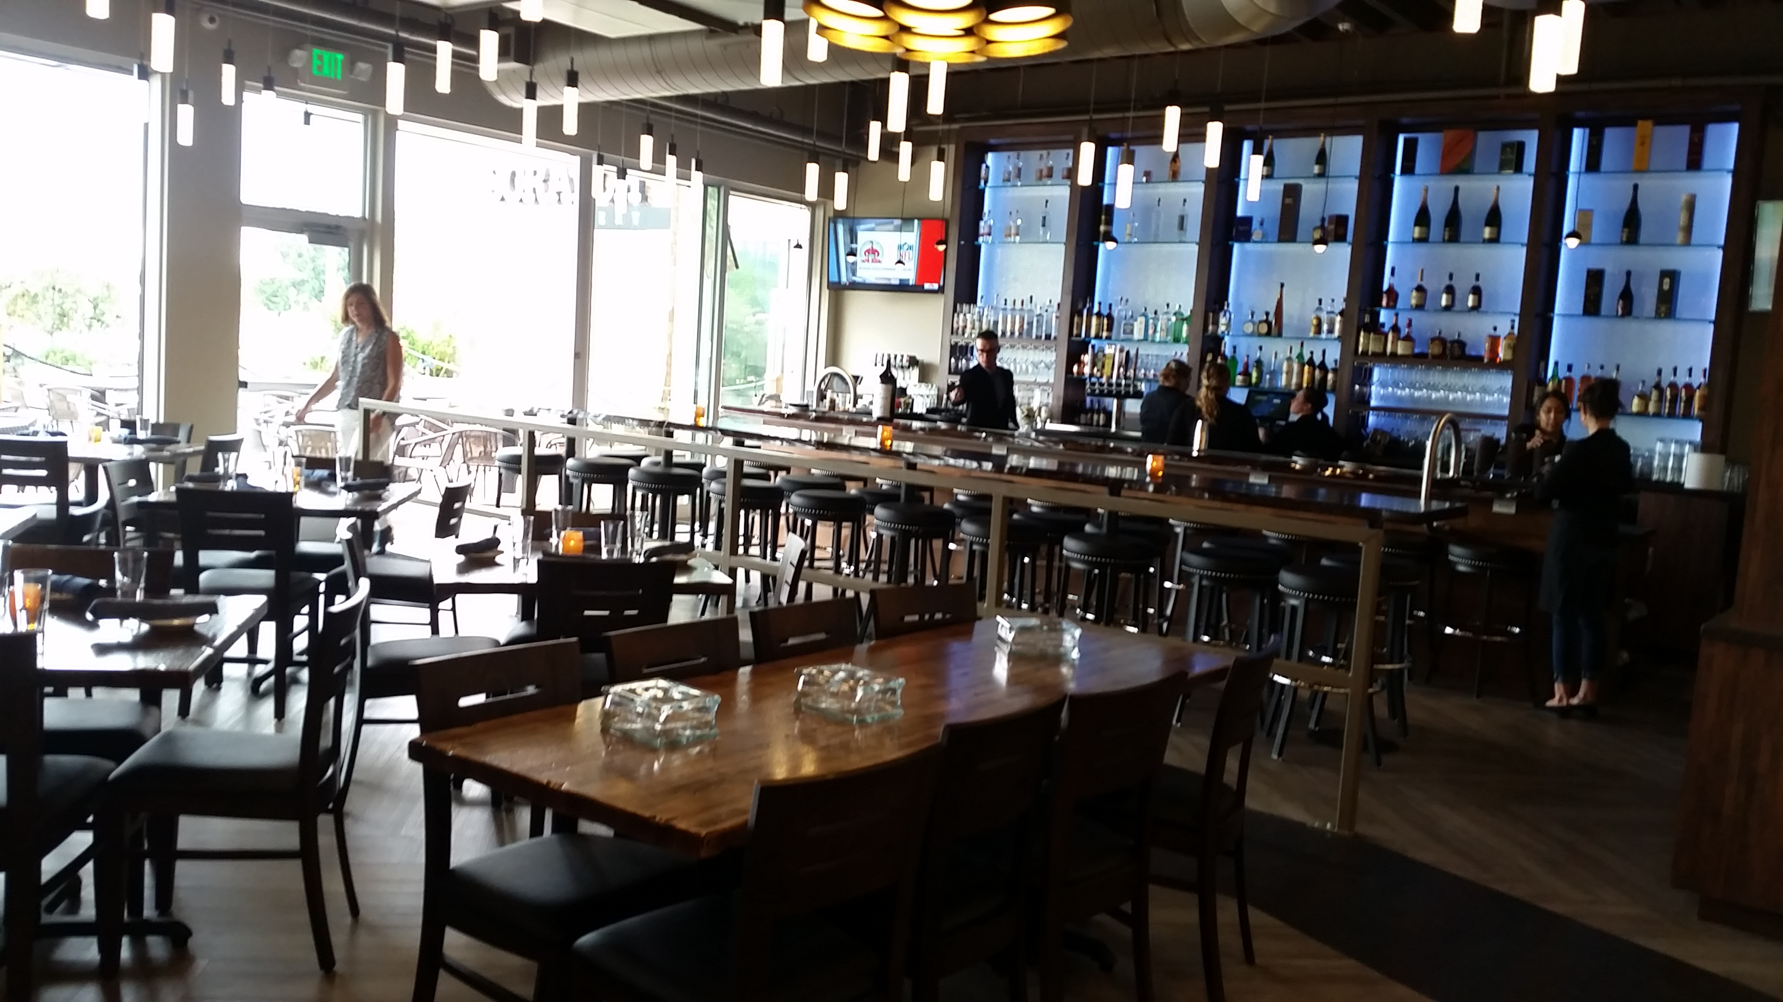
Results
Indian Restaurants continue to be the heart of most Indian cities around the country, serving as the most popular choice. International cuisine options though present are very rare. Cafes and Fast Food restaurants are also some options frequented upon. So even though Indian Restaurants are top priority, we can easily say judging from the clusters that the cities are seeing a moving trend in making cafes and fast food restaurants among the more popular options.
This Photo by Unknown Author is licensed under CC BY

